Slide 1
AirBnB
Aizelmarie Magsino
Christos Ferderigos
Jeffrey Kim
Michael Cruz

Slide 2
Motivation and Summary
Our project is to investigate the overall popularity of AirBnB listings in Jersey City. We’ll examine the Number of Listings and associated Rental Rates as well as identify Popular Room Types and Neighborhoods. With these variables, we are able to determine that:
Apartments are the most popular property type, with entire home/apt as the most popular room type
Downtown Jersey City has the most listings and most expensive listings
Journal Square has the most private single rooms
While there is no significant difference in average rental price by week day, average rental price of listings in Downtown peaks by late spring/early summer

Slide 3
Questions and Data
What AirBnB room types are available to rent in Jersey City?
Which property type has the most listings overall?
What are the more popular and most expensive neighborhoods in Jersey City?
What are the most popular listing types by neighborhood?

Slide 4
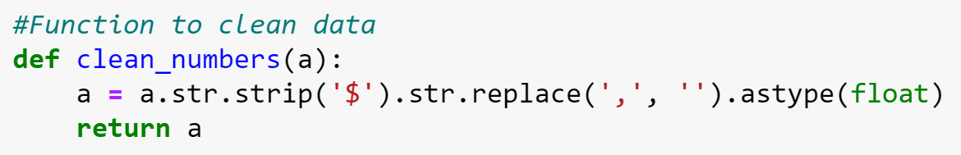
Data Cleanup & Exploration
Data sourced directly from AirBnB according to data collected in 2019 (As of October 2019)
Imported CSVs, removed unnecessary columns, and recast data types in order to perform calculations successfully
Used GMaps API in order to plot specific data points for heats maps and listing types by neighborhood

Slide 5
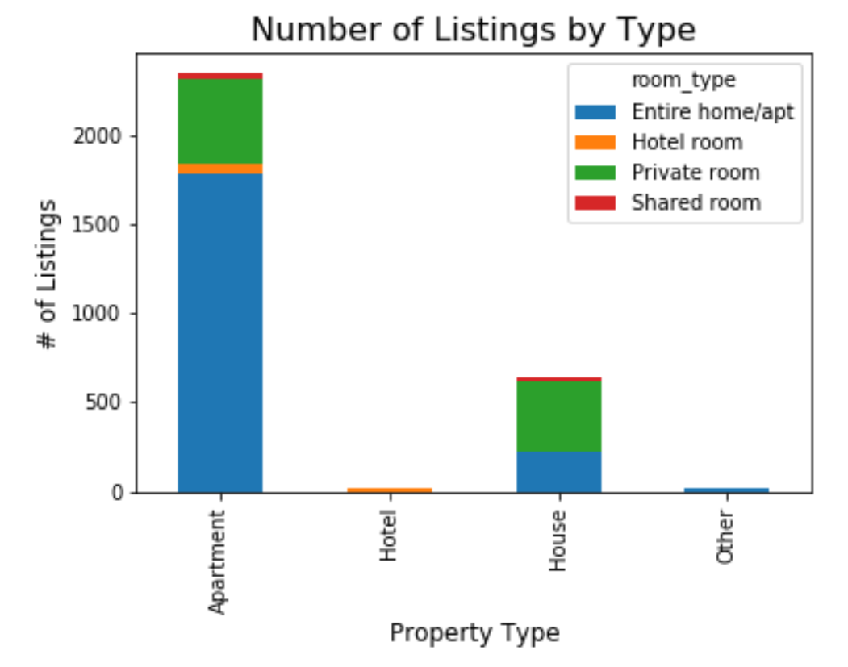
Data Analysis

Slide 6
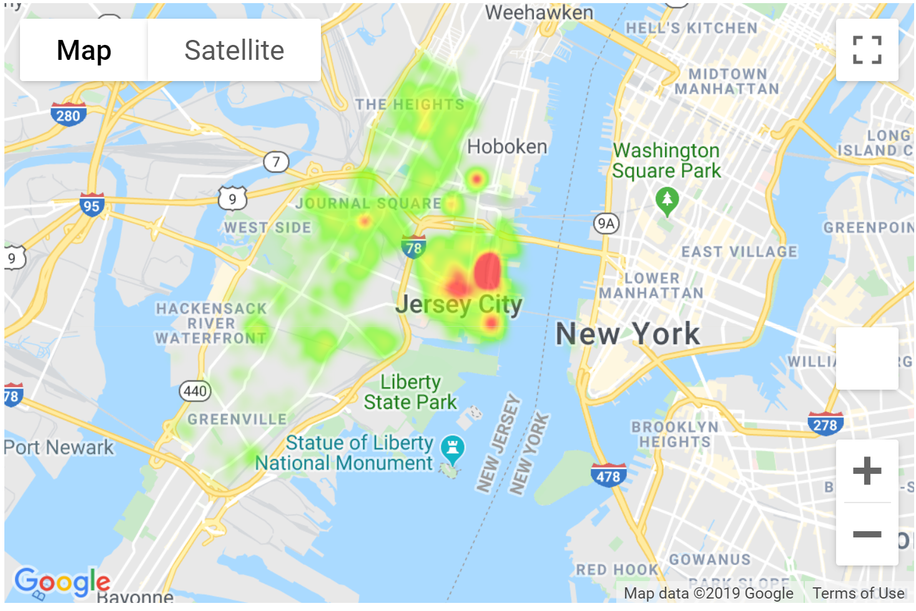
Heatmap of Price of Listings

Slide 7
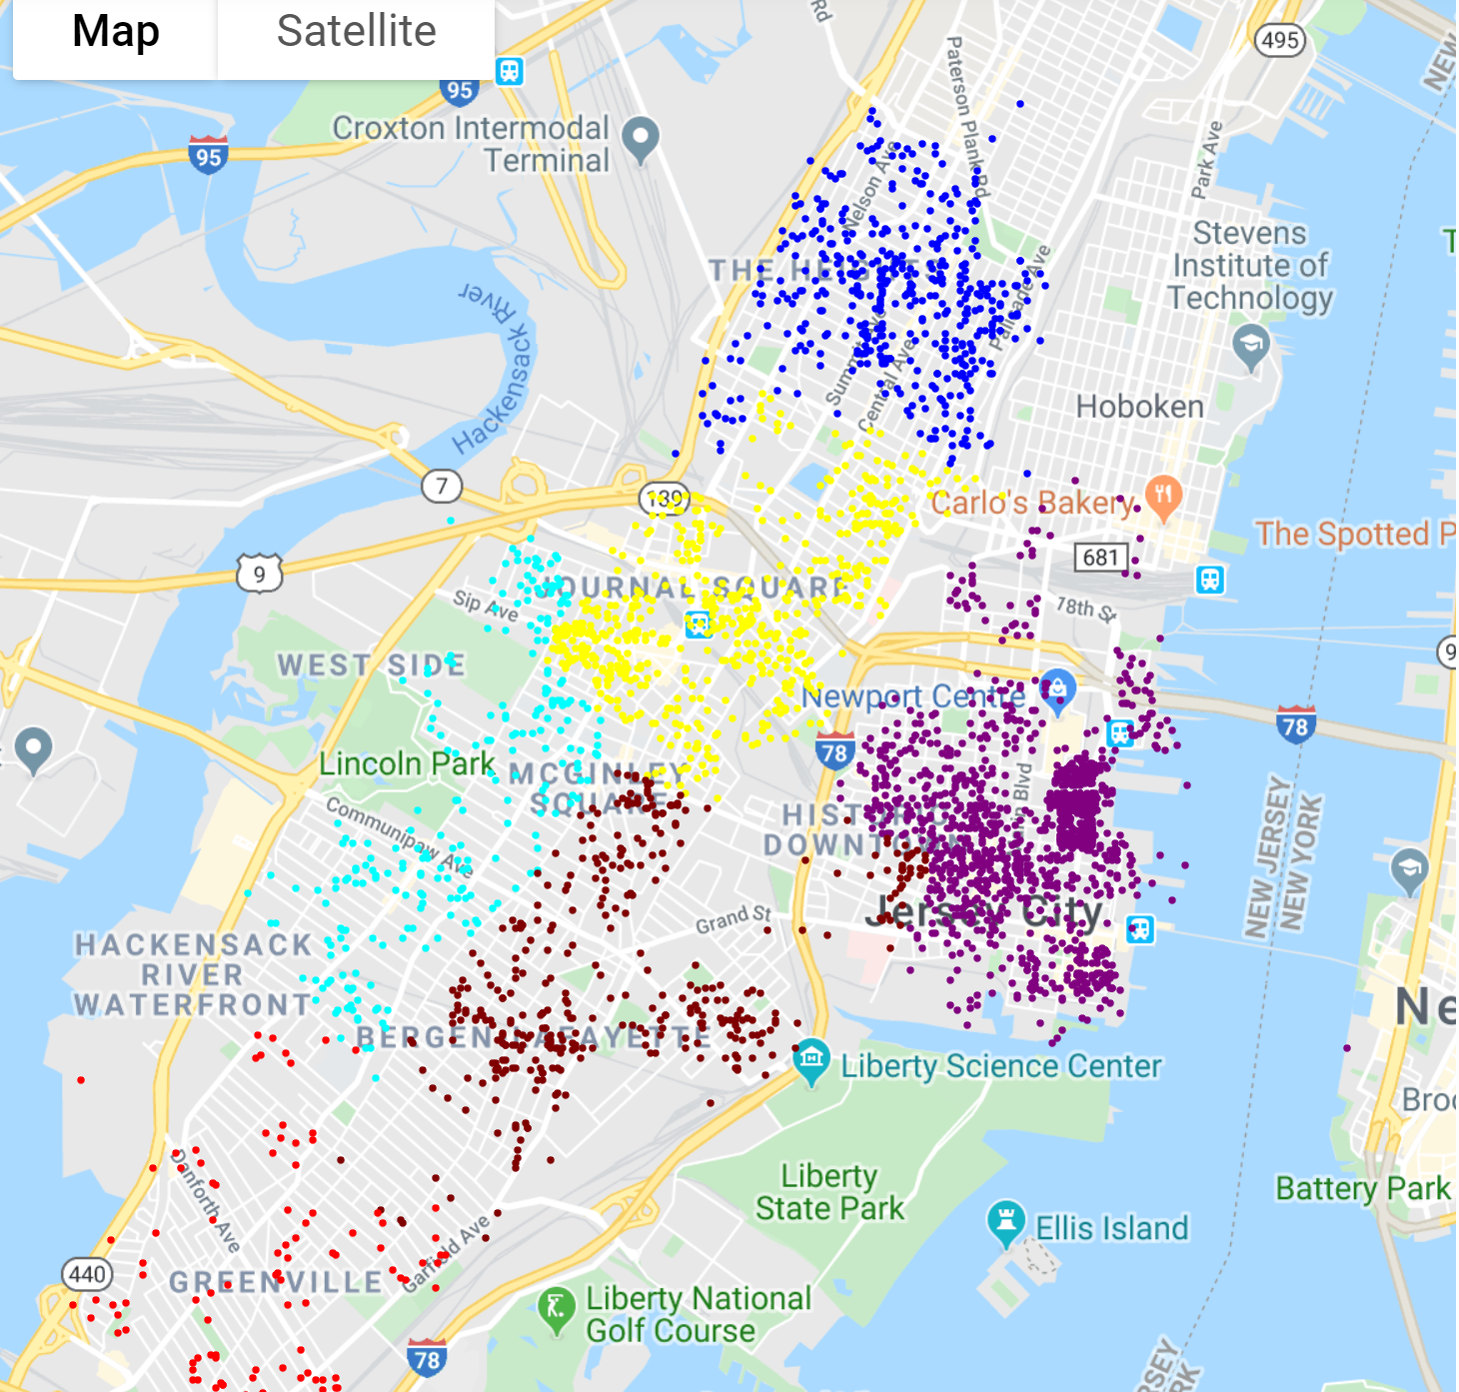
Listings by Neighborhood

Slide 8
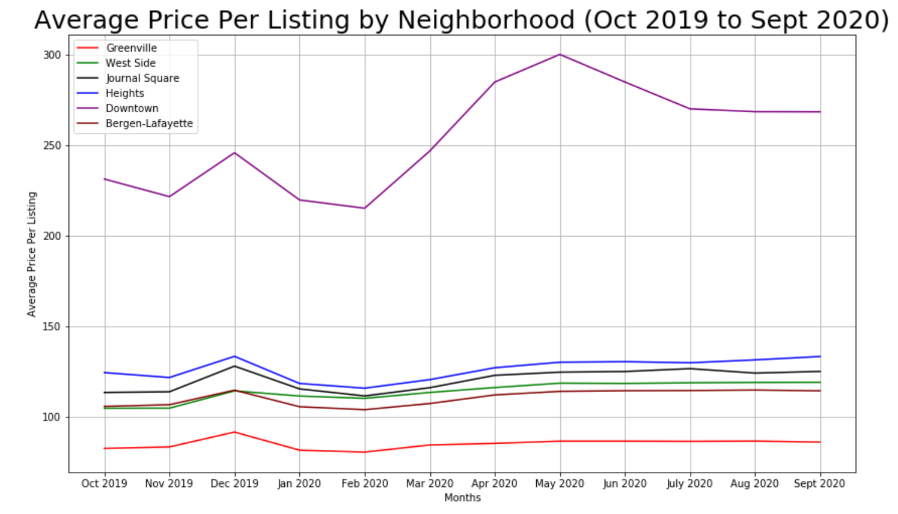
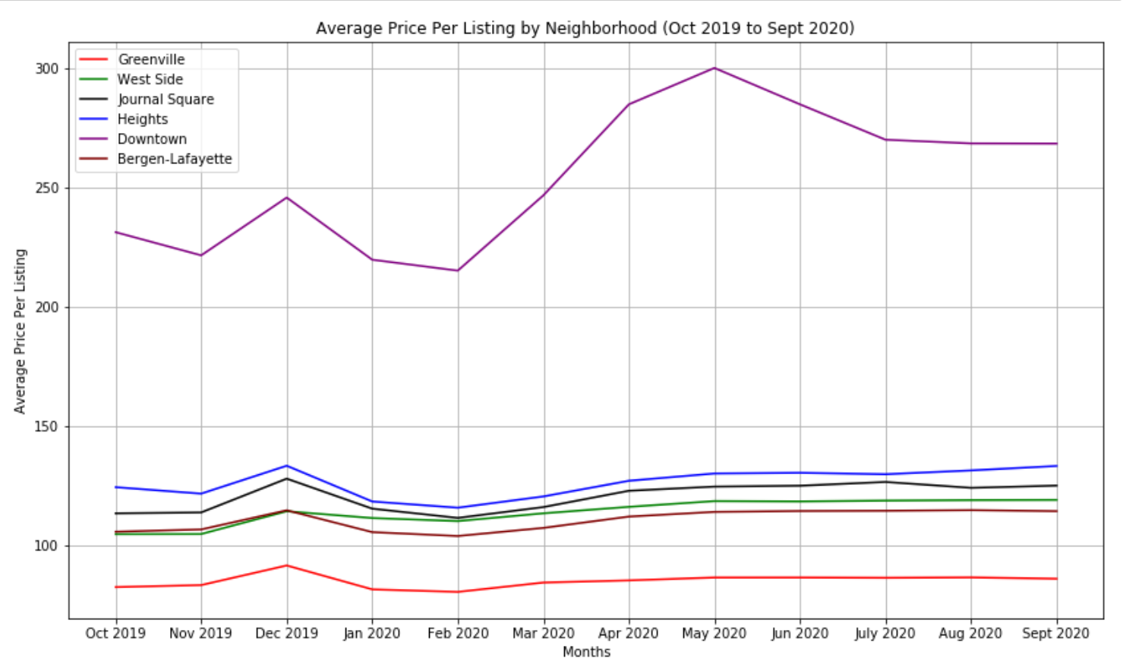

Slide 9
Discussion
Expectations:
Apartments to be the most popular AirBnB ✅
Weekend prices are more expensive than weekday prices ❌
Downtown Jersey City is the most popular neighborhood ✅
Smaller pricing discrepancies between neighborhoods ❌

Slide 10
Post Mortem
Challenges using GitHub Workflow
Complexities in AirBnB’s pricing structure
Lack of historical listings for trending
Include other data sets, such as household income levels and hotel prices by neighborhood, and correlate it to our findings

Slide 11
Q & A

